Slide 1
IEEE-123 Bus Single Phase System

Slide 2
Equivalent single phase 123-node system
voltage level for the system is 4.16 kV LL (2.4 kV LN)
transformer is removed by line with impedance (0.00001+j0.0001)
regulator is replaced by line segment with zero impedance
no capacitor in the system
To run base power flow following conditions are applied
all the load data is converted into star connected constant power load
no DG in the system
substation voltage at 1 pu (see IEEE123SinglePh.dss)
folder with the OpenDSS files‘IEEE123singlephase_baseOpenDSS’
Matlab calls OpenDSS using COM interface to solve powerflow
(see ‘IEEE123singlephase_basePowerflowvalidationOpenDSS_base.m’)

Slide 3
IEEE-123 Node System
OpenDSS base model
Matlab base model
This is the base case model for the IEEE 123 bus single phase model

Slide 4
Equivalent Matlab data
nodes are renumber to fit in the Matlab program
ex - node 150 == node 1
line capacitance is ignored
transformer is removed from the system
regulator is replaced by line segment with zero impedance
no capacitor in the system
To run base power flow following conditions are applied
all the load data is converted into star connected constant power load
no DG in the system
substation voltage at 1 pu
folder with the OpenDSS files ‘IEEE123singlephase_baseMatlab’

Slide 5

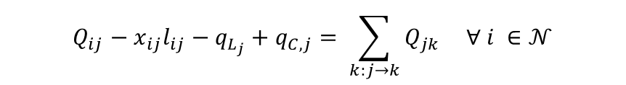
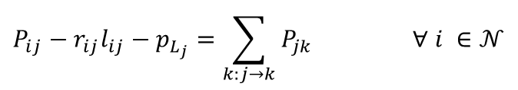
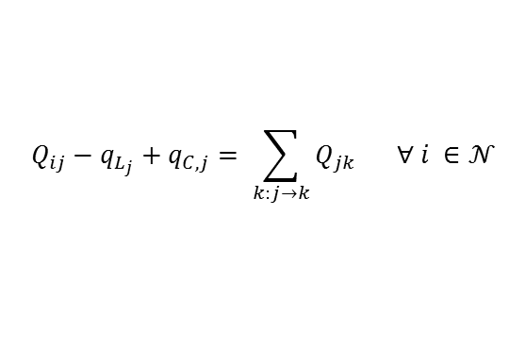
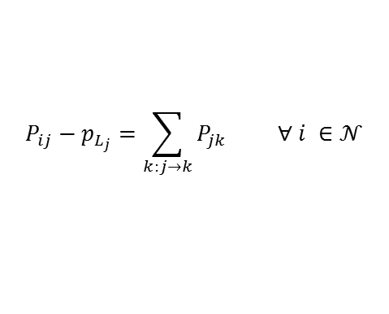

Branch flow model
Active power
$$P_{ij}−r_{ij}l_{ij}−p_{L_{j}}=\sum_{k:j→k}{P_{jk}} ∀ i ∈𝒩$$
Reactive power
$$Q_{ij}−x_{ij}l_{ij}−q_{L_{j}}+q_{C,j}= \sum_{k:j→k}{Q_{jk}} ∀ i ∈𝒩$$
Voltage drop
$$v_{j}=v_{i}−2\left(r_{ij}P_{ij}+x_{ij}Q_{ij}\right)+\left(r_{ij}^{2}+x_{ij}^{2}\right)l_{ij} ∀ i ∈𝒩$$
Current equation
$$l_{ij}v_{i}=P_{ij}^{2}+Q_{ij}^{2}$$
$$∀ i ∈𝒩$$
Linear branch flow model
$$P_{ij}−p_{L_{j}}=\sum_{k:j→k}{P_{jk}} ∀ i ∈𝒩$$
$$Q_{ij}−q_{L_{j}}+q_{C,j}= \sum_{k:j→k}{Q_{jk}} ∀ i ∈𝒩$$
$$v_{j}=v_{i}−2\left(r_{ij}P_{ij}+x_{ij}Q_{ij}\right) ∀ i ∈𝒩$$

Slide 6
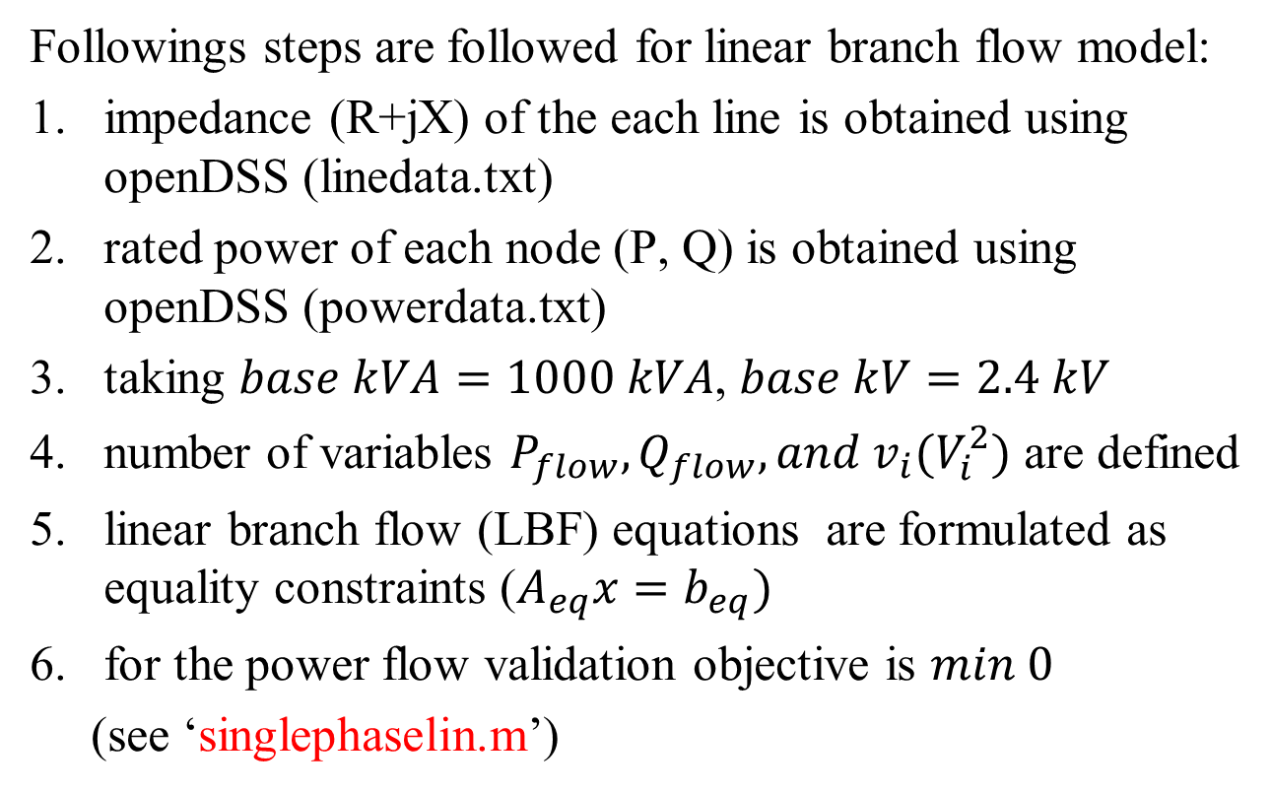
How to model in matlab?
Followings steps are followed for linear branch flow model:
impedance (R+jX) of the each line is obtained using openDSS (linedata.txt)
rated power of each node (P, Q) is obtained using openDSS (powerdata.txt)
taking $base kVA=1000 kVA$, $base kV=2.4 kV$
number of variables $P_{flow}, Q_{flow}, and v_{i}(V_{i}^{2})$ are defined
linear branch flow (LBF) equations are formulated as equality constraints ($A_{eq}x=b_{eq})$
for the power flow validation objective is $min 0$
(see ‘singlephaselin.m’)

Slide 7
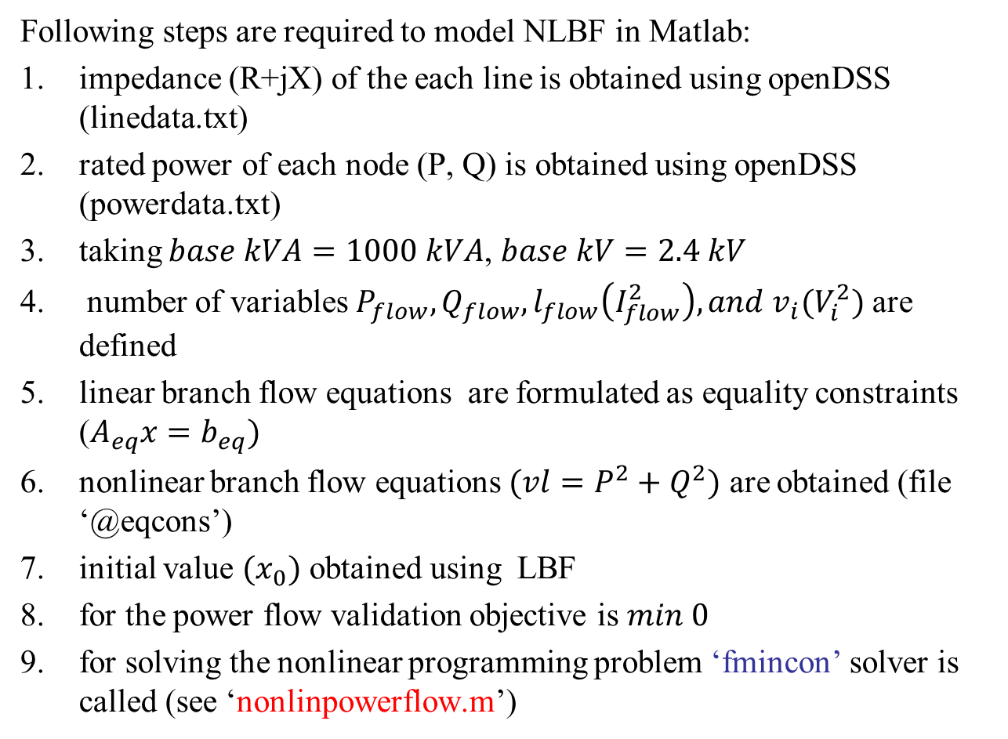
Nonlinear branch flow (NLBF) equation
Following steps are required to model NLBF in Matlab:
impedance (R+jX) of the each line is obtained using openDSS (linedata.txt)
rated power of each node (P, Q) is obtained using openDSS (powerdata.txt)
taking $base kVA=1000 kVA$, $base kV=2.4 kV$
number of variables $P_{flow}, Q_{flow}, l_{flow}\left(I_{flow}^{2}\right), and v_{i}(V_{i}^{2})$ are defined
linear branch flow equations are formulated as equality constraints ($A_{eq}x=b_{eq})$
nonlinear branch flow equations $(vl=P^{2}+Q^{2})$ are obtained (file ‘@eqcons’)
initial value $(x_{0})$ obtained using LBF
for the power flow validation objective is $min 0$
for solving the nonlinear programming problem ‘fmincon’ solver is called (see ‘nonlinpowerflow.m’)

Slide 8
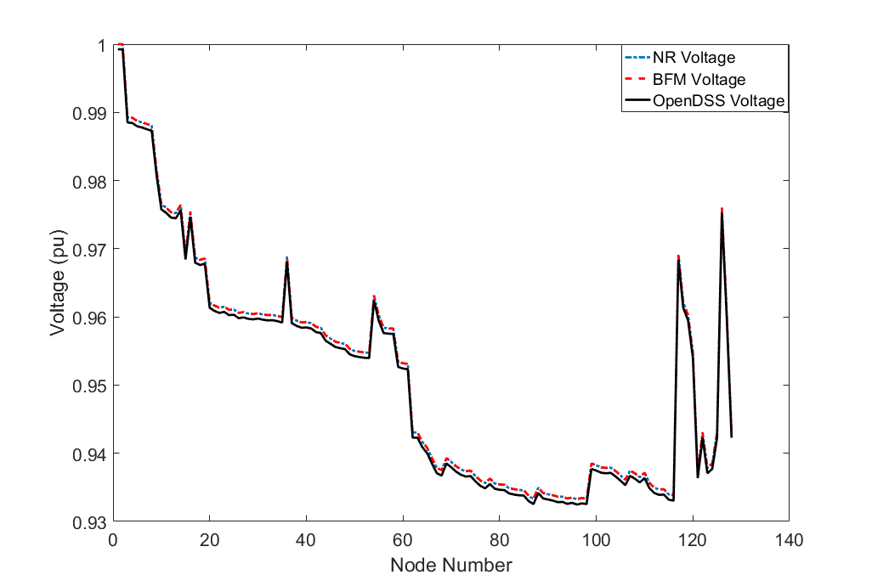
Power flow validation
Base case power flow at substation
OpenDSS |  | Matlab
Active Power (kW) | Reactive Power (kVAr) | Active Power (kW) | Reactive Power (kVAr)
1201.5 | 716.71 | 1201.6 | 717.0
Voltage comparison between OpenDSS and Matlab

Slide 9
IEEE 123 Bus feeder with 10% DG Penetration
DGs are placed randomly at 10% of load nodes
DGs rating at each node is equal to maximum rating of the load demand
DGs kVA rating is 120% of kW rating
Folder with OpenDSS and Matlab file ‘IEEE123singlephase_DG10’
OpenDSS model
Matlab model

Slide 10
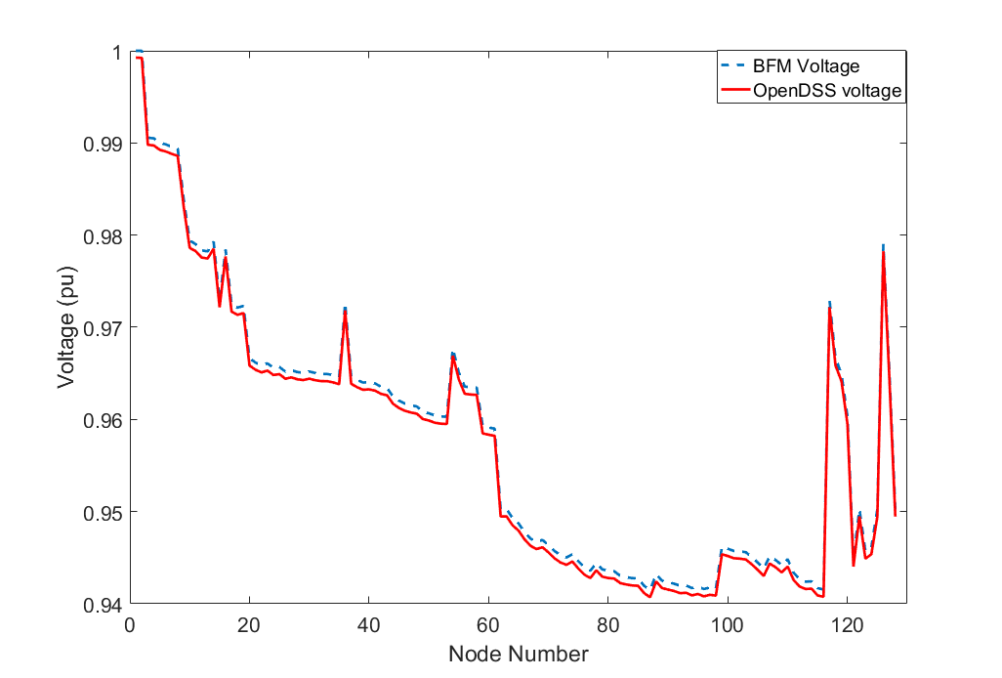
Power flow validation
Power flow at substation with 10% DG penetration
OpenDSS |  | Matlab
Active Power (kW) | Reactive Power (kVAr) | Active Power (kW) | Reactive Power (kVAr)
930.59 | 691.33 | 930.6 | 691.6
Voltage comparison between OpenDSS and Matlab

Slide 11
IEEE 123 Bus feeder with 30% Penetration
DGs are placed randomly at 30% of load nodes
DGs rating at each node is equal to maximum rating of the load demand
DGs kVA rating is 120% of kW rating
Folder with OpenDSS and Matlab file ‘IEEE123singlephase_DG30’
OpenDSS model
Matlab model

Slide 12
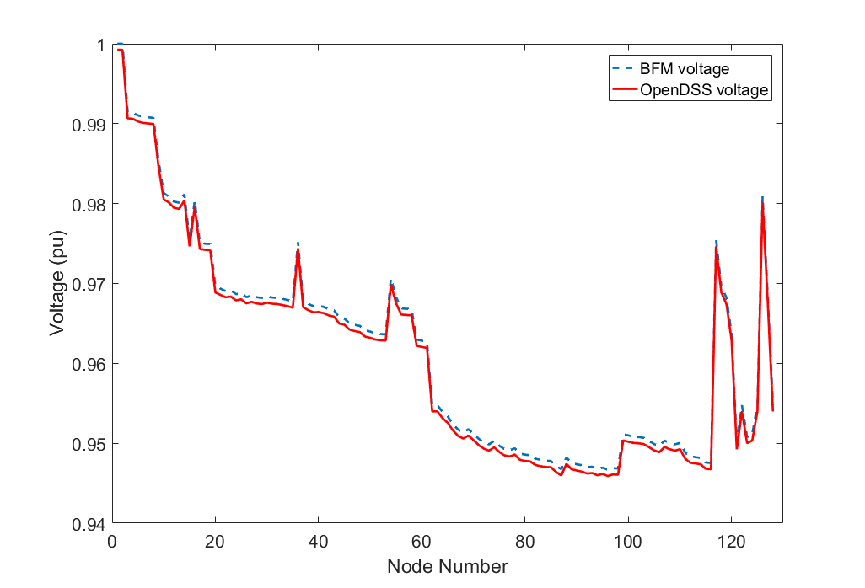
Power flow validation
Power flow at substation with 30% DG penetration
OpenDSS |  | Matlab
Active Power (kW) | Reactive Power (kVAr) | Active Power (kW) | Reactive Power (kVAr)
737.63 | 678.51 | 737.6 | 678.8
Voltage comparison between OpenDSS and Matlab

Slide 13
IEEE 123 Bus feeder with 50% Penetration
DGs are placed randomly at 50% of load nodes
DGs rating at each node is equal to maximum rating of the load demand
DGs kVA rating is 120% of kW rating
Folder with OpenDSS and Matlab file ‘IEEE123singlephase_DG50’
OpenDSS model
Matlab model

Slide 14
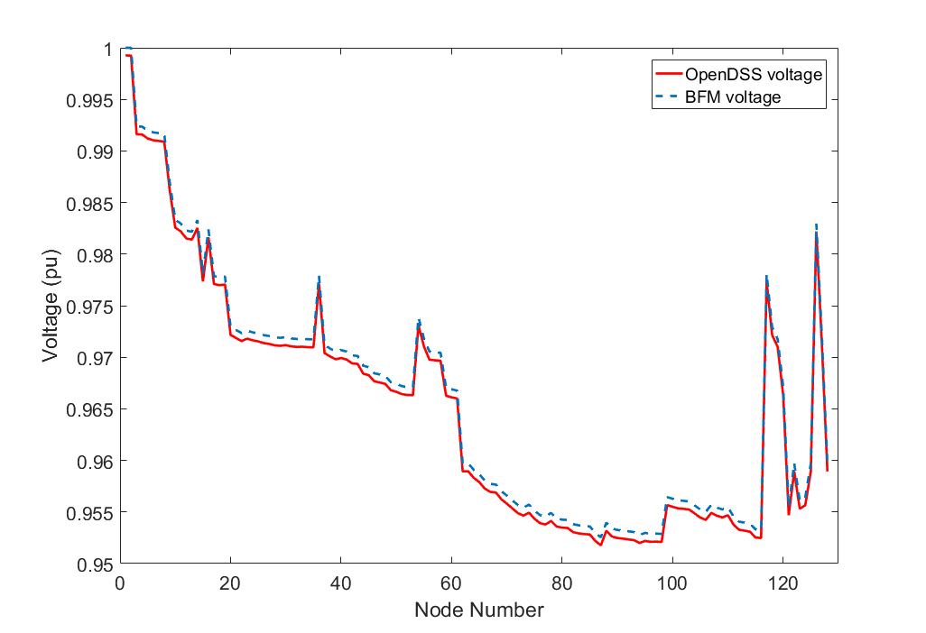
Power flow validation
Power flow at substation with 50% DG penetration
OpenDSS |  | Matlab
Active Power (kW) | Reactive Power (kVAr) | Active Power (kW) | Reactive Power (kVAr)
527.32 | 667.76 | 527.2 | 668.0
Voltage comparison between OpenDSS and Matlab

Slide 15
IEEE-123 Node System
This is the base case model for the IEEE 123 bus single phase model with 4 voltage regulator and 4 capacitor banks
The addition of PV at each node for 10%, 30% and 50% penetration is similar to previous slides

Slide 16
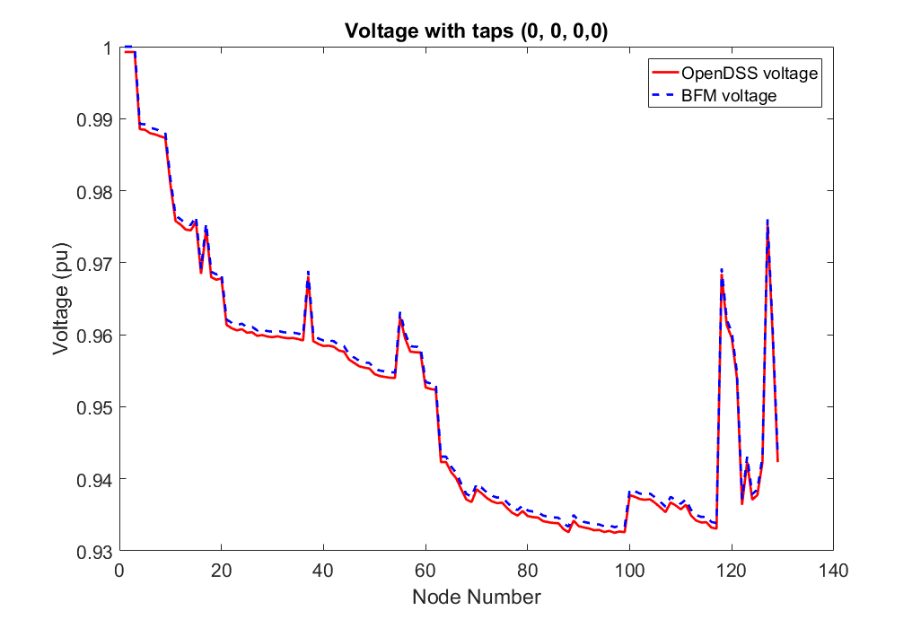
Power flow validation base case
Power flow at substation with four VR and four capacitor banks
OpenDSS |  | Matlab
Active Power (kW) | Reactive Power (kVAr) | Active Power (kW) | Reactive Power (kVAr)
1201.45 | 716.69 | 1201.6 | 717.1
Here all the capacitor banks switch are ON and supplying their rated Q
Tap positon of all the voltage regulators are 0
Voltage comparison between OpenDSS and Matlab

Slide 17
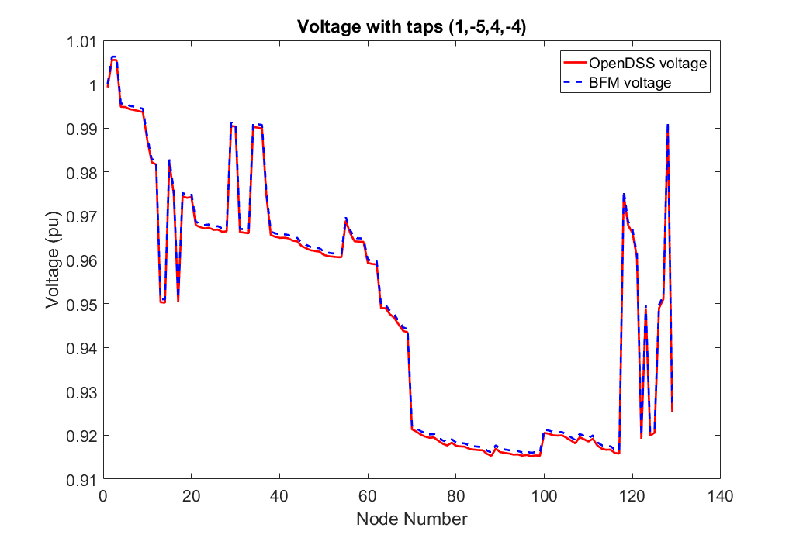
Power flow validation base case
Power flow at substation with four VR and four capacitor banks
Matlab |  | OpenDSS
Active Power (kW) | Reactive Power (kVAr) | Active Power (kW) | Reactive Power (kVAr)
1201.2 | 716.2 | 1201.05 | 715.9
Here all the capacitor banks switch are ON and supplying their rated Q
Tap positon of all the voltage regulators are 1,-5,4 and -4
Voltage comparison between OpenDSS and Matlab

Slide 18
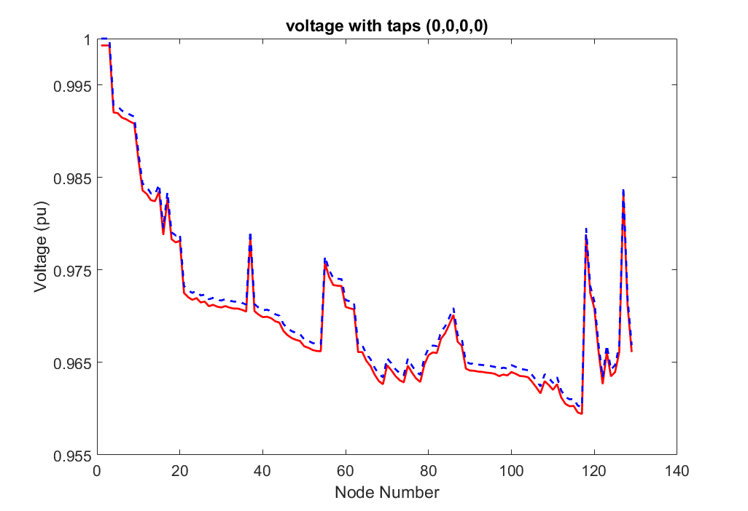
Power flow validation with 10% penetration
Power flow at substation with four VR and four capacitor banks
Matlab |  | OpenDSS
Active Power (kW) | Reactive Power (kVAr) | Active Power (kW) | Reactive Power (kVAr)
924.8 | 429.8 | 924.8 | 429.5
Here all the capacitor banks switch are ON and supplying their rated Q
Tap positon of all the voltage regulators are 0
Voltage comparison between OpenDSS and Matlab

Slide 19
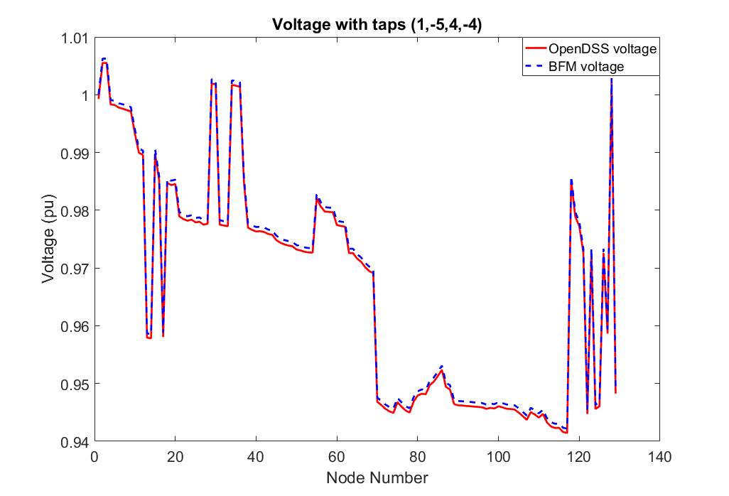
Power flow validation with 10% penetration
Power flow at substation with four VR and four capacitor banks
Matlab |  | OpenDSS
Active Power (kW) | Reactive Power (kVAr) | Active Power (kW) | Reactive Power (kVAr)
924.6 | 429.4 | 924.8 | 429.2
Here all the capacitor banks switch are ON and supplying their rated Q
Tap positon of all the voltage regulators are 1,-5,4,-4
Voltage comparison between OpenDSS and Matlab

Slide 20
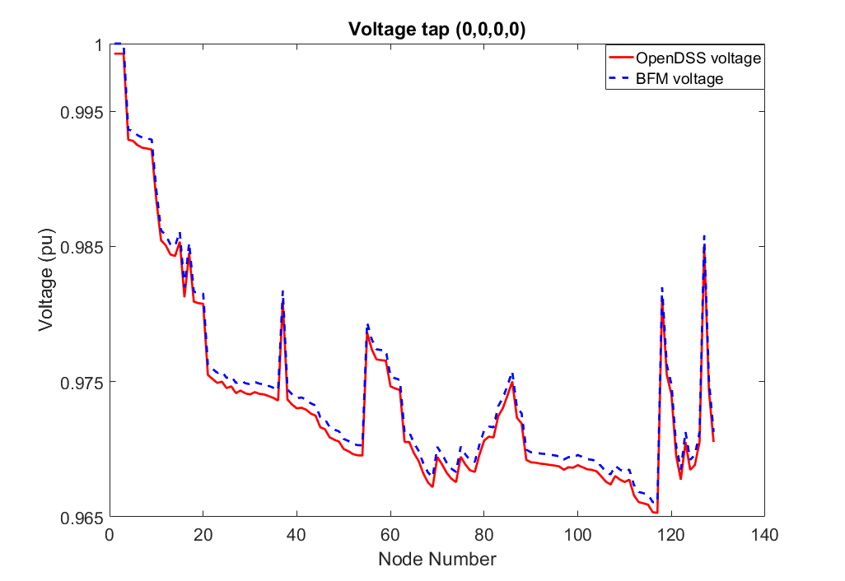
Power flow validation with 30% penetration
Power flow at substation with four VR and four capacitor banks
Matlab |  | OpenDSS
Active Power (kW) | Reactive Power (kVAr) | Active Power (kW) | Reactive Power (kVAr)
732.0 | 417.4 | 732.06 | 417.12
Here all the capacitor banks switch are ON and supplying their rated Q
Tap positon of all the voltage regulators are 0
Voltage comparison between OpenDSS and Matlab

Slide 21
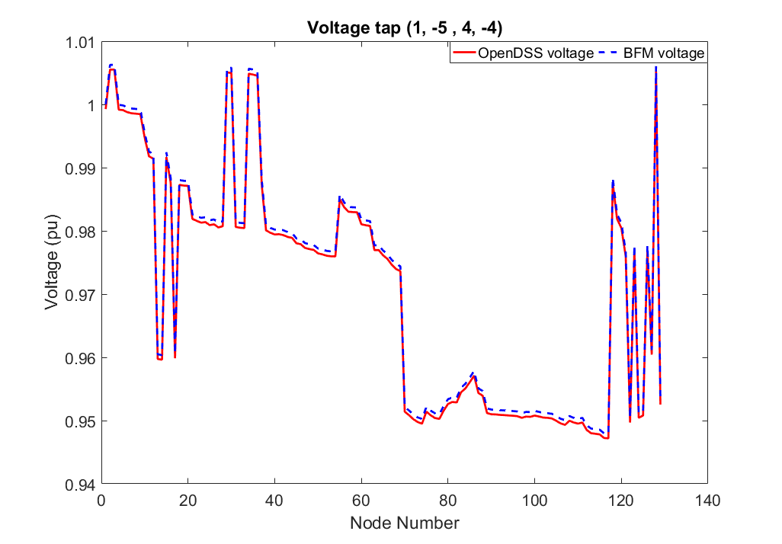
Power flow validation with 30% penetration
Power flow at substation with four VR and four capacitor banks
Matlab |  | OpenDSS
Active Power (kW) | Reactive Power (kVAr) | Active Power (kW) | Reactive Power (kVAr)
731.9 | 417.2 | 732.26 | 417.07
Here all the capacitor banks switch are ON and supplying their rated Q
Tap positon of all the voltage regulators are 1,-5,4,-4
Voltage comparison between OpenDSS and Matlab

Slide 22
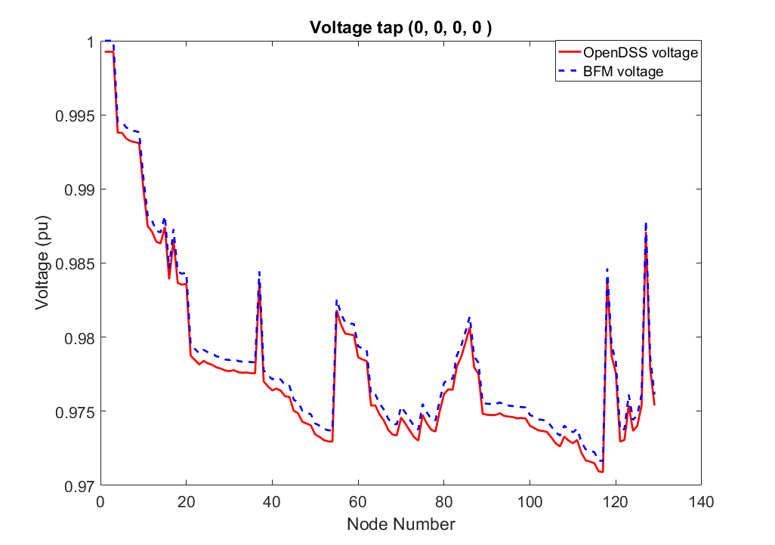
Power flow validation with 50% penetration
Power flow at substation with four VR and four capacitor banks
Matlab |  | OpenDSS
Active Power (kW) | Reactive Power (kVAr) | Active Power (kW) | Reactive Power (kVAr)
521.9 | 407.0 | 521.89 | 406.71
Here all the capacitor banks switch are ON and supplying their rated Q
Tap positon of all the voltage regulators are 0
Voltage comparison between OpenDSS and Matlab

Slide 23
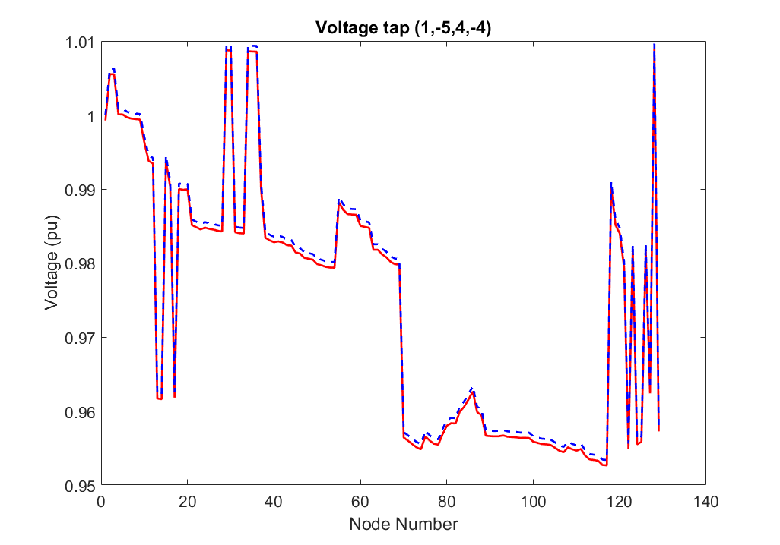
Power flow validation with 50% penetration
Power flow at substation with four VR and four capacitor banks
Matlab |  | OpenDSS
Active Power (kW) | Reactive Power (kVAr) | Active Power (kW) | Reactive Power (kVAr)
521.8 | 406.9 | 521.83 | 406.59
Here all the capacitor banks switch are ON and supplying their rated Q
Tap positon of all the voltage regulators are 1,-5,4,-4
Voltage comparison between OpenDSS and Matlab

Slide 24
Power flow validation with Capacitor and 1 Voltage Regulator
Base case power flow at substation
Legacy Device | OpenDSS |  | Matlab
Status | Active Power (kW) | Reactive Power (kVAr) | Active Power (kW) | Reactive Power (kVAr)
C sw = 1, VR tap=0 | 1195.3 | 454.2 | 1195.3 | 454.03
C sw = 1, VR tap=1 | 1194.9 | 453.5 | 1194.9 | 453.14
C sw = 1, VR tap=-5 | 1197.7 | 459.0 | 1197.6 | 458.65
Power flow at substation with 10% DG penetration
Legacy Device | OpenDSS |  | Matlab
Status | Active Power (kW) | Reactive Power (kVAr) | Active Power (kW) | Reactive Power (kVAr)
C sw = 1, VR tap=0 | 924.8 | 429.8 | 924.83 | 429.51
C sw = 1, VR tap=-1 | 925.1 | 430.4 | 925.07 | 430.04
C sw = 1, VR tap=5 | 923.6 | 427.3 | 923.55 | 426.93

Slide 25
Power flow validation with Capacitor and 1 Voltage Regulator
Power flow at substation with 30% DG penetration
Legacy Device | OpenDSS |  | Matlab
Status | Active Power (kW) | Reactive Power (kVAr) | Active Power (kW) | Reactive Power (kVAr)
C sw = 1, VR tap=0 | 732.0 | 417.4 | 732.07 | 417.13
C sw = 1, VR tap=1 | 731.9 | 417.1 | 731.79 | 416.69
C sw = 1, VR tap=-5 | 733.0 | 419.4 | 733.01 | 419.06
Power flow at substation with 50% DG penetration
Legacy Device | OpenDSS |  | Matlab
Status | Active Power (kW) | Reactive Power (kVAr) | Active Power (kW) | Reactive Power (kVAr)
C sw = 1, VR tap=0 | 521.9 | 407.0 | 521.89 | 406.71
C sw = 1, VR tap=1 | 521.8 | 406.8 | 521.84 | 406.51
C sw = 1, VR tap=-5 | 522.5 | 408.3 | 522.54 | 407.95

